Slide 1
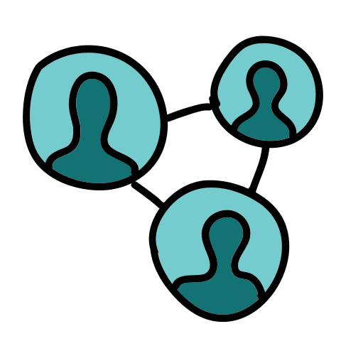
Spotting Suspicious Academic Citations Using Self-Learning Graph Transformers
Capstone Project Phase A – 61998
Project number:
24-1-R-16
Presenters:
Almog Madar
Mor Ben Haim

Slide 2
Manipulated citations
Manipulated citations, a grave threat to academic integrity, involve the intentional inclusion of references in academic works for biased advantages, rather than for their genuine academic merit.
These citations do not support the author's arguments or provide relevant background information; their primary purpose is to inflate the citation count of the author artificially
As mentioned in the literature, more than two-thirds of references in a paper are deemed unnecessary.
This finding provides further evidence of the widespread presence of dubious citations.

Slide 3
Capturing Patterns Using Network-Based Approaches
Manual inspection techniques and basic statistical analyses were used in the past, but they were limited in capturing complex patterns and subtle manipulations.
New network-based approaches have emerged as promising methods for spatially identifying and understanding manipulations and citations in recent years.
By adopting the structure and relationships within the citation network, network-based methods could detect hidden and anomalous relations that indicate citation manipulation.
The analysis is not focused on a single paper but delves into the dynamics of the entire broad network to generate a deep and comprehensive understanding of manipulation patterns.

Slide 4
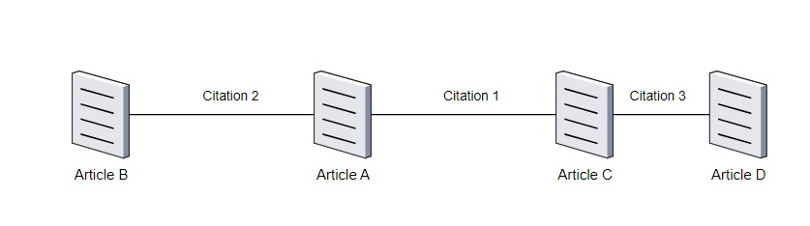



Citation Network
A citation network, or citation graph, is a directed graph that depicts the citations within a collection of documents.
Each node (or vertex) in the graph represents a document in the collection.
Each directed edge from one document to another represents a citation.
In this project, we consider a simplification of the problem of working with undirected graphs

Slide 5
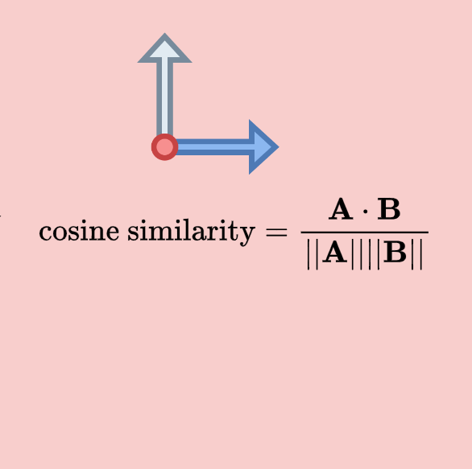

Main Idea
The main idea is to use graph masking for checking of the edges reability
Part of the graph is masked and the rest of the network is used as the study material for a neural network constructed to provide link prediction within the masked part.
Edges with cosine scores greater or equal to the threshold (Tr) will be considered as real (stable) edges of the citation network.
Otherwise, the edge is suspected to be manipulated.
Notes:
Edge Based Cosine Scores :
Compare the prediction scores with the threshold (Tr)
Edges with scores greater or equal to the threshold (Tr) are classified as real edges. These are likely valid connections in the graph.
Edges with scores less than the threshold (Tr) are classified as manipulated edges. These connections are suspect and might be unreliable.

Slide 6





Cornerstones
Ego – Graph
Positional Encoding

Slide 7

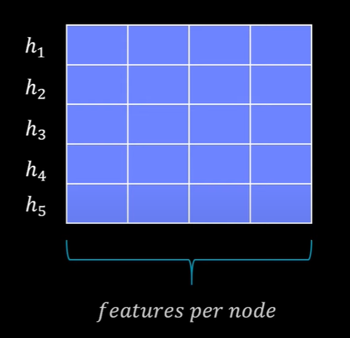


Ego - Graph
An ego-graph, also known as an ego network, is a subgraph in graph theory that focuses on one node, known as the ‘ego’, and its immediate neighbors.
These neighbors are often referred to as ‘alters’. The ego-graph includes the ego, the alters, and all the edges among them
Node features
1
5
2
4
3
Ego graph features matrix[1 , 5 , 4]

Slide 8
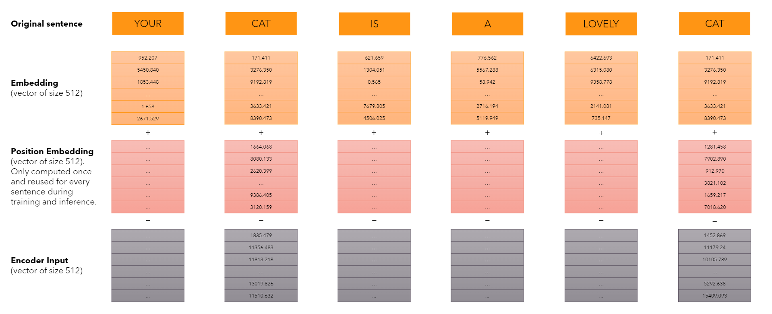
Positional Encoding
In NLP, positional encoding is a technique that allows neural networks to learn meaningful representations of the order of words in a sentence.
Notes:
Positional encoding is similarly essential in graph mining, where the order of nodes and edges in a graph can give important information about the relationships between entities.
(“Positional encoding is important in graph mining too. The sequence of nodes and edges in a graph can give us useful information about how different things are connected.”)

Slide 9

Positional Encoding
Graphormer proposed three types of positional encodings to jointly capture the structural information of graphs, which are the centrality encoding, the spatial encoding, and the edge encoding.
Basic Ego graph [1 , 5 , 4]
Centrality encoding , Spatial encoding , Edge encoding
Notes:
(principle)
Graphormer, a powerful graph representation learning model, leverages positional encoding to capture the structural information of graphs effectively.
Positional encoding is similarly essential in graph mining, where the order of nodes and edges in a graph can give important information about the relationships between entities. (“Positional encoding is important in graph mining too. The sequence of nodes and edges in a graph can give us useful information about how different things are connected.”)
centrality encoding == degree centralities .
spatial encoding == shortest path distances (floyd warshall).
the edge encoding == the edge features respectively.

Slide 10
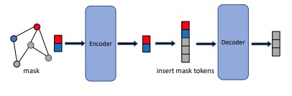


Training
Graph Masked Autoencoders (GMAEs) are a type of self-supervised, transformer-based model designed for learning graph representations.
The key features of GMAEs include a masking mechanism and an asymmetric encoder-decoder design.
The masking mechanism in GMAEs involves taking partially masked graphs as input. The purpose of this is to reconstruct the features of the masked nodes, which is a form of self-supervised learning.
This means that the model is trained to predict or fill in the missing parts of the input data, which can help it learn useful features and representations of the data.
Mask_predicted
5 | 4 | 3
$$MSE(mask_{target},mask_{predicted})$$
$$N⋅x$$
$$M⋅x$$
5 | 4 | 3
Mask_target
Notes:
If panel, ask about hyper-pram:
Cora:
Batch size == 32 , Mask Ratio == 0.8 , n_encoder_layers == 4 , n_decoder_layers == 2 .
Citeseer:
Batch size == 64 , Mask Ratio == 0.7 , n_encoder_layers == 8 , n_decoder_layers == 2 .

Slide 11
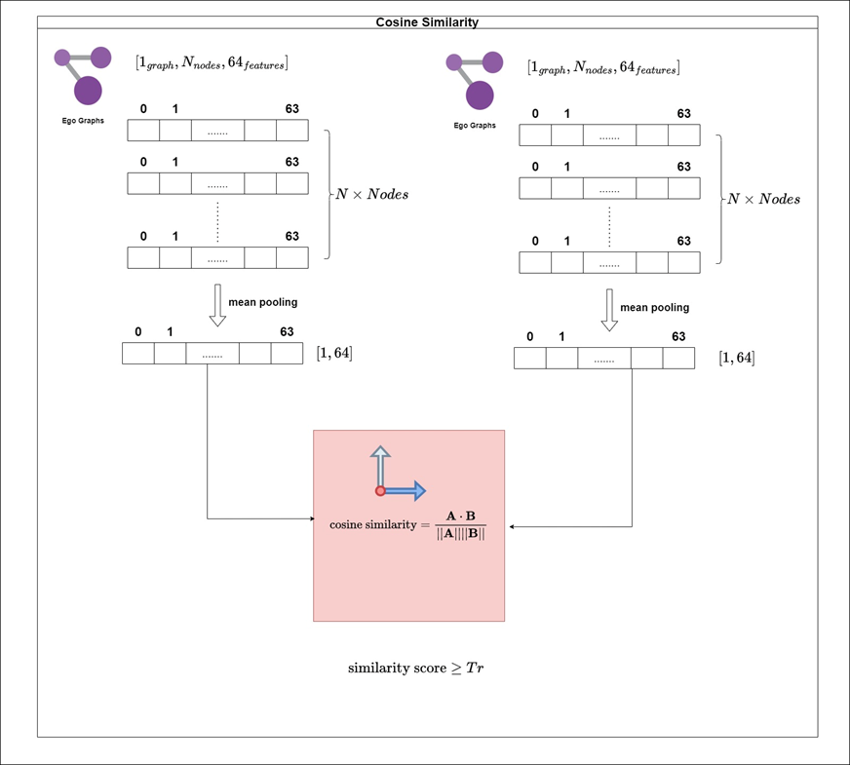








Reconstruct masked connections
After we training the deep network by partial data (based on 70% nodes). We need to reconstruct the citation network of the omitted masked nodes (30%) by identifying potential links with similarity scores that meet or exceed the threshold (Tr).
Does the connection meet
the threshold(Tr) condition ?
Recover Sub Citation Network
(Based on 30% nodes)
Notes:
After training the encoder, the model performs similarity analysis on unseen vectors representing ego-graphs from the testing set.
Unseen Testing Set Vectors: We introduce new, unseen vectors representing ego-graphs from the testing set. The encoder did not encounter these vectors during training.
Learnable Encoder Application: These unseen testing set vectors are fed through the trained encoder. Recall that the encoder incorporates learnable tokens to capture the overall graph structure, allowing it to generalize to unseen data.
Essentially, this process evaluates the encoder's ability to generalize to unseen data by analyzing the similarity between ego-graphs in the testing set based on their encoded representations and cosine similarity scores.

Slide 12
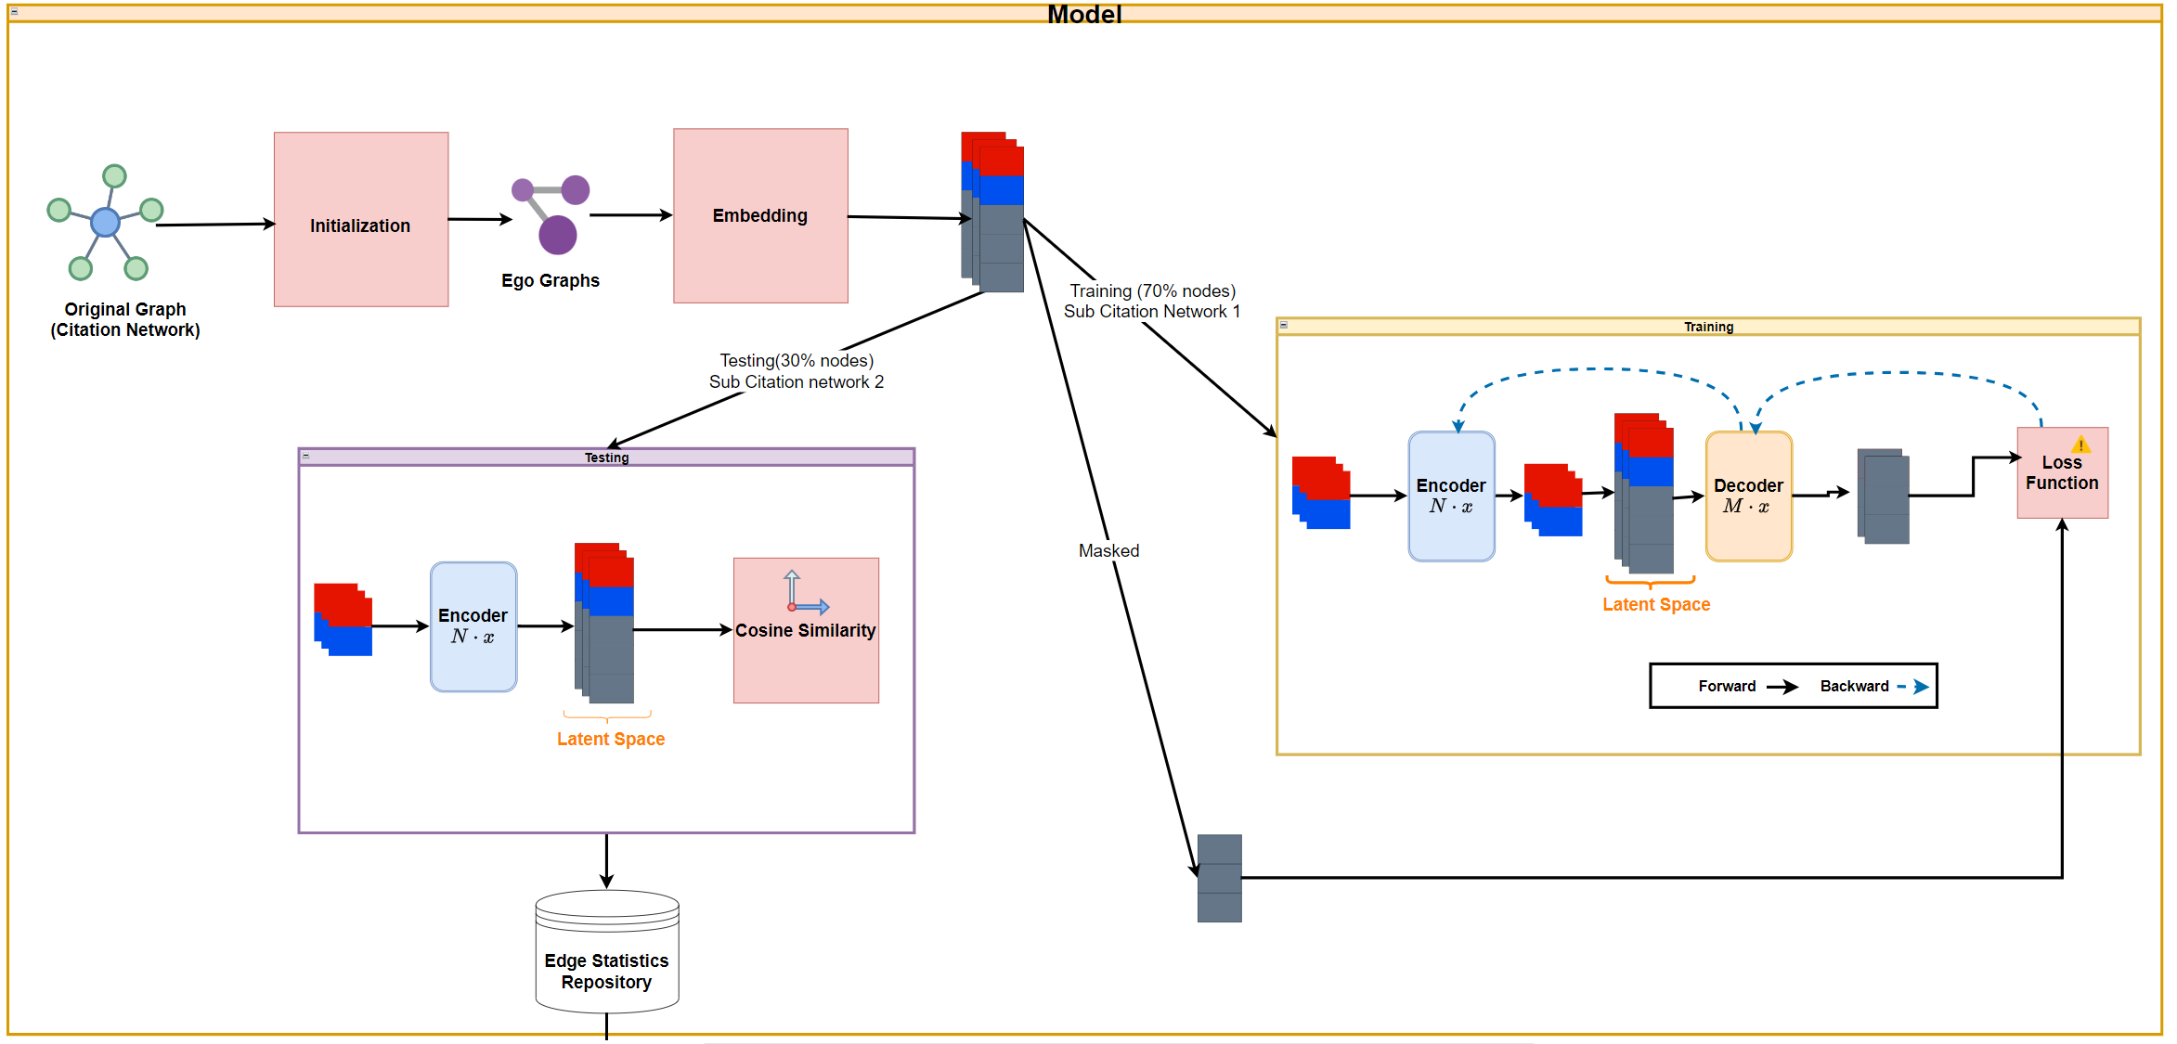
Architectural Development for Model Research

Slide 13
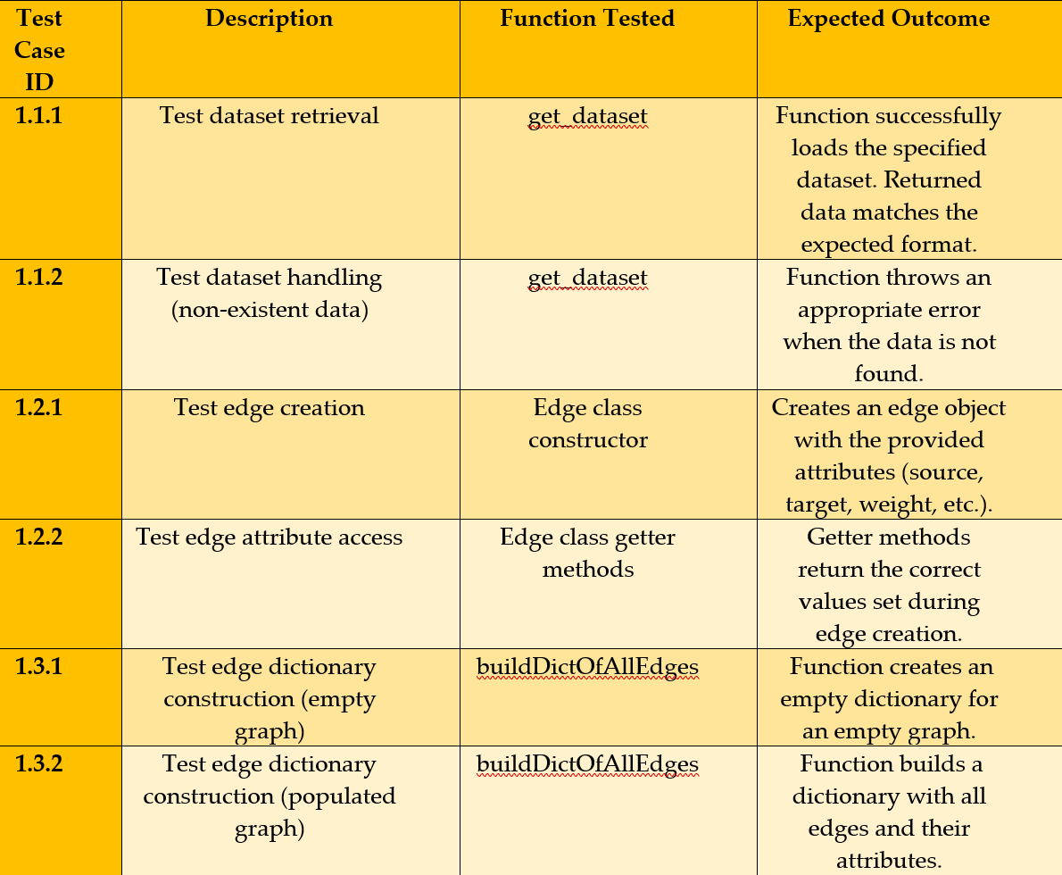
Testing Plan

Slide 14
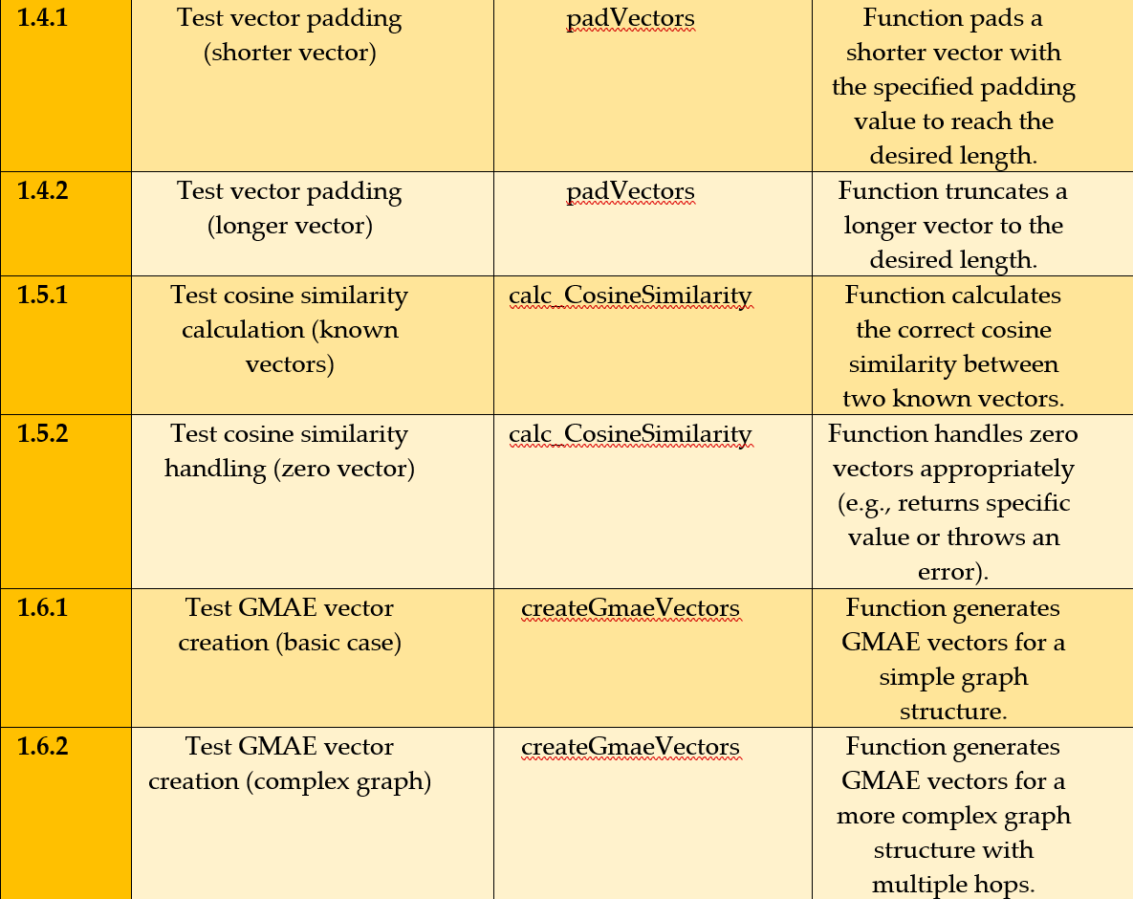
Testing Plan

Slide 15

Thanks for listening …

